Slide 1
Vibrational spectrum for structures with 2 atoms/primitive basis
Linear diatomic chain:
2n-2
2n-1
2n
2n+1
2n+2
Note different convention for a than Kittel. I have a good reason!
C
a
2a
u_{2n-2}
u_{2n-1}
u_{2n}
u_{2n+1}
u_{2n+2}
Equation of motion for atoms on even positions:
Only the labeling convenient is different from monatomic.
If that’s all, why might this be any different from monatomic?
Why should we label it differently?
Equation of motion for atoms on odd positions:
Solution with:
and
Notes:
A and B are amplitudes of the motion of the two different atoms. The amplitudes need not be the same, but they could be.
The book actually makes the distance between same atoms a instead of my choice of 2a. Both are common. You will see shortly why I choose the axis this way. By doing this, I’m able to directly compare my result to the monatomic lattice as I make the masses more similar (next slide)
It’s also good for you to see it solved two different ways, so you can appreciate the subtle differences it makes in the solution.

Slide 2
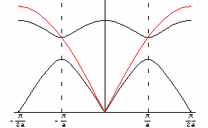
What happens?
Show video
2
2
ω²=C
±C
,
Notes:
What happens? B cancels out after substitution for A.
The books solves this with matrices, which is also fine. I’ll show you another way.
Only got here in 75 minute class (slide 18), got to 24 nice time (have flexible ending)

Slide 3
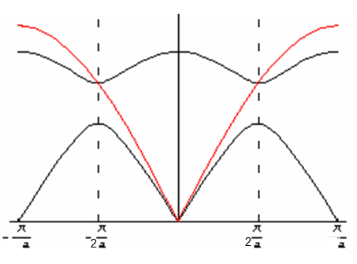
Technically longitudinal only in 1D
Transverse acoustic mode for diatomic chain
A/B=1
Notes:
Again, in 1D, these should all be longitudinal, but in 3D we have both. (longitudinal is harder to interpret/visualize in my opinion, so that’s why I keep showing these tranverse ones

Slide 4
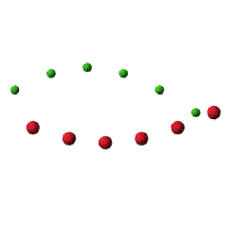
Transverse optical mode for diatomic chain
Technically longitudinal only in 1D
Amplitudes
of different atoms
A/B=-m/M
Transverse acoustic mode for diatomic chain
A/B=1
Notes:
Again, in 1D, these should all be longitudinal, but in 3D we have both. (longitudinal is harder to interpret/visualize in my opinion, so that’s why I keep showing these tranverse ones

Slide 5
Longitudinal Eigenmodes in 1D
What if the atoms were opposite charged?
Optical Mode: These atoms, if oppositely charged, would form an oscillating dipole which would couple to optical fields with λ~a
Notes:
For example, an ionic crystal, where we know an electron transfers from one atom to the other. What would be different between these two?

Slide 6
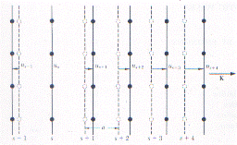
Phonon Dispersion in 3D
1D model
The 1D model can be extended to 3D if the variables u refer not to displacements of atoms but planes of atoms.
3D model

Slide 7
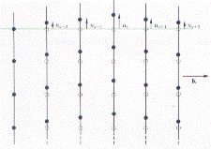
Phonon Dispersion in 3D
1D model
The 1D model can be extended to 3D if the variables u refer not to displacements of atoms but planes of atoms.
Need to include motions that are perpendicular to the wave vector.
3D model

Slide 8
Phonon Dispersion in 3D
1D model
The 1D model can be extended to 3D if the variables u refer not to displacements of atoms but planes of atoms.
Need to include motions that are perpendicular to the wave vector.
These are called transverse acoustic modes (TA), as opposed to longitudinal acoustic modes (LA).
3D model

Slide 9
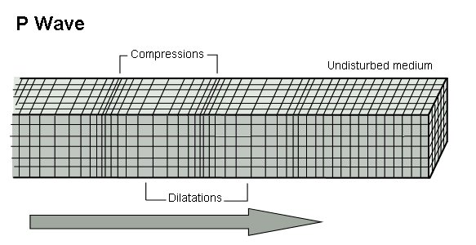
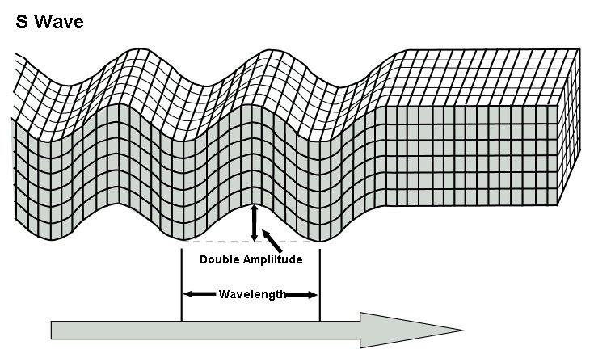
3D Dispersion curves
Every 3D crystal has 3 acoustic branches, 1 longitudinal and 2 transverse
Are the branches degenerate?
“Primary wave” = faster wave→ LA
“Secondary wave” = slower wave→ TA
No, the perpendicular displacements will have different force (“spring”) constants from the longitudinal force constants.
Example: Earthquake waves
Notes:
But frequently allow directions of high symmetry, the two transverse frequencies will be the same

Slide 10
Would you expect the two transverse branches to be degenerate?
Think about a tetragonal lattice to debate this.
Notes:
It depends on the symmetry. They can be. They might not be. In the case of the tetragonal, it will actually depend if the wave is moving along the elongated direction or not.

Slide 11
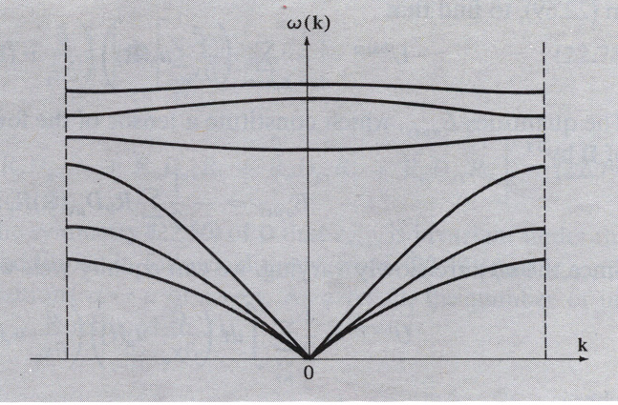
Number and Type of Branches
Every crystal has 3 acoustic branches, 1 longitudinal and 2 transverse
Every additional atom in the primitive basis contributes 3 further optical branches (again 2 transverse and 1 longitudinal)
Sometimes transverse will be degenerate
How would you know which
branch is longitudinal?
p atoms/primitive unit cell ( primitive basis of p atoms):
3 acoustic branches
+ 3(p-1) optical branches
= 3p branches
1LA +2TA
(p-1)LO +2(p-1)TO
How many branches and of what type for a perovskite ABO₃?
Notes:
This is why I spend so much time making sure you knew the difference between primitive and conventional. Conventional are useful for structure factor, but we don’t want them for this.
How many will a perovskite have?
3*5 = 15 branches, 1LA, 2TA, 4LO and 8TO
Question for me to look up sometime: What happens when perovskite is no longer cubic and unit cell is larger (such as rhombohedral). The above logic would suggest more bands. Perhaps some bands split into slightly different bands? What effect does that have on material properties?

Slide 12
2D Square Lattice
Write down the equation(s) of motion and guess solution

Slide 13
2D Square Lattice
Write down the equation(s) of motion and guess solution
U_{l,m+1}
How would you add in second nearest neighbor interactions?
U_{lm}
U_{l-1,m}
U_{l+1,m}
How will ṻ relate to u?
U_{l,m-1}

Slide 14
2D Lattice
U_{l,m+1}
$$ω^{2}=\frac{2C}{M}(2−\cos{k_{x}}a−\cos{k_{y}}a)$$
K
Compare to 1D solution:
$$ω^{2}=\frac{2C}{M}\left(1−\cos{ }ka\right)$$
U_{lm}
U_{l-1,m}
U_{l+1,m}
U_{l,m-1}

Slide 15
2D Lattice
U_{l,m+1}
$$ω^{2}=\frac{2C}{M}(2−\cos{k_{x}}a−\cos{k_{y}}a)$$
K
Compare to 1D solution:
$$ω^{2}=\frac{2C}{M}\left(1−\cos{ }ka\right)$$
U_{lm}
U_{l-1,m}
U_{l+1,m}
How do you think you might change this if a rectangular lattice?
U_{l,m-1}

Slide 16
2D Lattice
U_{l,m+1}
$$ω^{2}=\frac{2C}{M}(2−\cos{k_{x}}a−\cos{k_{y}}a)$$
K
Plot w vs k for the [10] and [11] directions.
Identify the values of ω at k=0 and at the BZ edges. (Hint: draw the BZ first)
U_{lm}
U_{l-1,m}
U_{l+1,m}
U_{l,m-1}

Slide 17
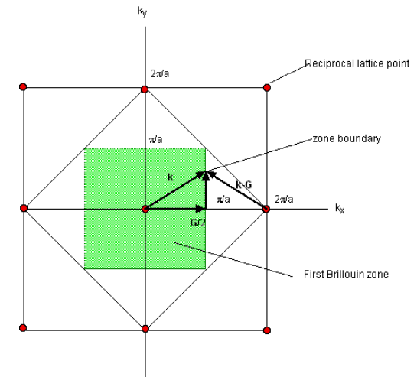
2D Lattice
$$ω^{2}=\frac{2C}{M}(2−\cos{k_{x}}a−\cos{k_{y}}a)$$
K
Plot w vs k for the [10] and [11] directions.
Identify the values of ω at k=0 and at the BZ edges. (Hint: draw the BZ first)
U_{lm}
U_{l-1,m}
U_{l+1,m}
U_{l,m-1}

Slide 18
$$ω^{2}=\frac{2C}{M}(2−\cos{k_{x}}a−\cos{k_{y}}a)$$
K
Plot w vs k for the [10] and [11] directions.
Identify the values of ω at k=0 and at the BZ edges. (Hint: draw the BZ first)
U_{lm}
U_{l-1,m}
U_{l+1,m}
U_{l,m-1}

Slide 19
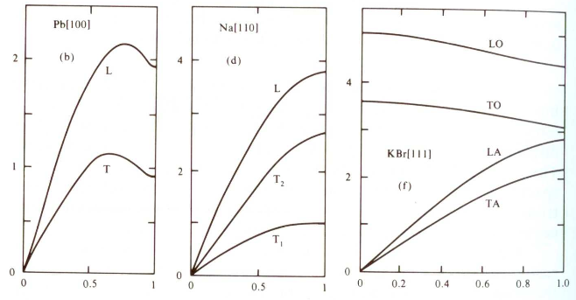
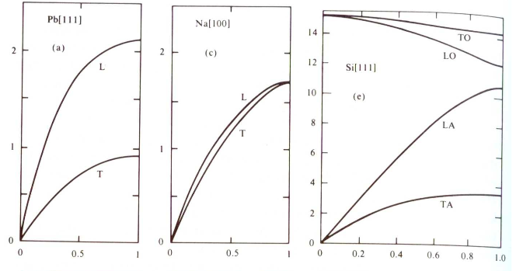
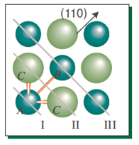
Real Phonon Spectra Might Look Slightly Different
What are some differences?
Why might they be different?
fcc bcc fcc, 2 atoms
Notes:
LA always greater energy than TA, but not always the case for LO versus TO
Na is bcc, Pb is fcc, Si is fcc/diamond, KBr has the NaCl crystal structure (which was fcc with different atoms in the basis)
A difference is that we have different curves (means we have different effective spring constants along different directions).
Another difference is that sometimes you get a downturn before reaching the edge of the Brillouin zone. This (at least typically) is a potential effect when including more that just nearest neighbor interactions. You see even in the same material, it doesn’t happen along all directions.

Slide 20
Real Phonon Spectra Might Look Slightly Different
What are some differences?
Why might they be different?
fcc bcc fcc, 2 atoms
Remember we made several simplifications:
Interactions beyond nearest neighbors are not included
Assumed harmonic potential
Ignored electron-phonon coupling
Notes:
LA always greater energy than TA, but not always the case for LO versus TO
Na is bcc, Pb is fcc, Si is fcc/diamond, KBr has the NaCl crystal structure (which was fcc with different atoms in the basis)
A difference is that we have different curves (means we have different effective spring constants along different directions).
Another difference is that sometimes you get a downturn before reaching the edge of the Brillouin zone. This (at least typically) is a potential effect when including more that just nearest neighbor interactions. You see even in the same material, it doesn’t happen along all directions.

